Slide 1
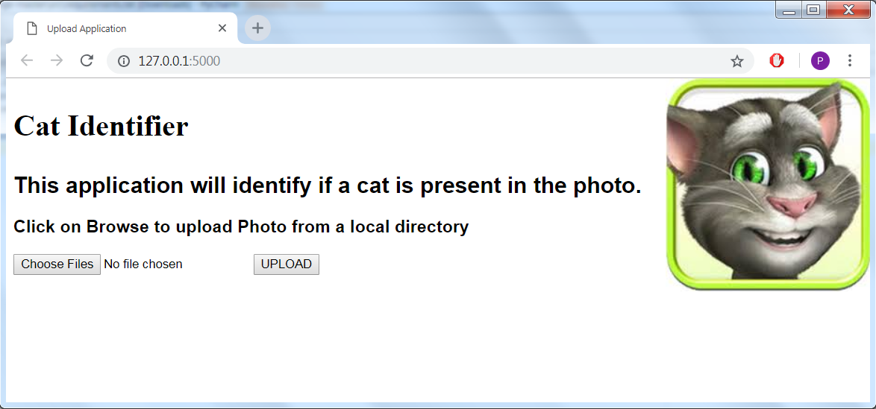
Cat Detector Application
Presenter: Prerna Prateek

Slide 2
Split the problem into three parts
Application for Image Upload and Save to disk
Designed Front-End using HTML and CSS
Used “form” tag and constrained on only File of type Image to get uploaded
Machine Learning Model to identify if Image has Cat
Used Google Cloud Vision API
Method to send saved Image to Machine Learning Model
Backend was created in Flask in Python 3

Slide 3
Google’s Cloud Vision API
Easy to create API key and using its RESTful API
Has high Rate Limiting (free1000 images/day)
Built-in Pre-trained Models for Object Detection
Generates labels detected within the Image
Associates a Score with each label
Gives Scope to alter and change the Model for Object Detection

Slide 4
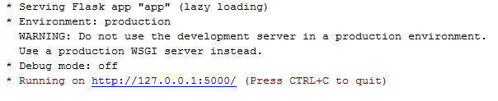
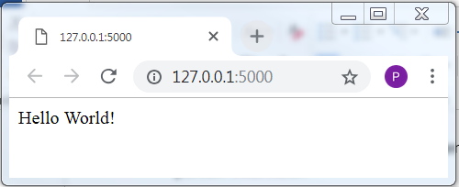
How Flask creates App!
from flask import Flask
app = Flask(__name__)
@app.route("/")
def hello():
return "Hello World!“
if __name__ == "__main__":
app.run()

Slide 5
Key Components of Flask Used
render_template(): When provided with the name of the template and the variables as keyword arguments, it renders a template. Flask will look for templates in the templates folder
request(): Helps application to access the file from the files dictionary on the request object
url_for(): Builds a URL to a specific function

Slide 6
Description of Built-in Python Library
os: module provides a portable way of using operating system dependent functionality
mkdir
path
join/isdir/abspath/dirname
base64: provides functions for encoding binary data to printable ASCII characters and decoding such encodings back to binary data
google-api-python-client: Enables accessing Google API
GoogleCredentials: Takes JSON file of credentials and authorizes to use a web service

Slide 7
Request-Response Cycle
Flask App Sends Requests to Cloud Vision API
Request has encoded image data and information about Model to use on image
Cloud Vision API returns Response with processed information
Python code handles the Response and gets prediction
Returns to Flask App to display Result in Front-End

Slide 8
Importance of Pytest
Helps to document expected behavior of Code
Fixtures can be created once and used multiple times
Ensures one part of Code Change does not break/affect other parts
Gives facility to “mock” certain parts of code for creating unit-tests

Slide 9
Thank You!

